Slide 1
Data-Level Parallelism in
Vector, SIMD and GPU Architectures
(Chapter 4)

Slide 2
Outline
Vector Architecture
SIMD Instruction Set Extensions for Multimedia
Graphics Processing Units

Slide 3
Vector Architecture
In a vector machine, a single instruction operates on vectors of data.
Basic Idea
  Read sets of data elements into “vector registers”
  Operate on those registers
  Disperse the results back into memory

Slide 4
An example of vector machine- RV64V
Main Memory
Structure of RV64V
Vector
Load/Store
FP Add/Sub
Vector
Registers
FP Mult
FP Divide
Integer
Logical
Scalar
Registers

Slide 5
The RV64V contains vector registers, vector functional
units, vector load/store unit, and a set of scalar registers.
Vector registers: RV64V has eight vector registers, and
each vector register holds 64 elements, each 64 bits
wide.
Vector functional units: Each unit is fully pipelined, and
it can start a new operation on every clock cycle.
Vector load/store unit: The vector memory unit loads or
stores a vector to or from memory.
A set of scalar registers: Scalar registers can also provide
data as input to the vector functional unit, as well as
compute addresses to pass to the vector load/store unit.

Slide 6
RV64V Instructions
vld v0, x1: Load vector register v1 from memory starting
at address stored in x1
vst v1, x1: Store vector register v1 into memory starting
at address stored in x1
vadd v1,v2,v3: Add elements of v2 and v3, and put
each result in v1.
vadd v1,v2,f0: Add f0 to each element of v2, then
put each result in v1.
vmul v1,v2,v3: Multiply elements of v2 and v3, and put
each result in v1.
vmul v1,v2,f0: Multiply each element of v2 by f0, then
put each result in v1.

Slide 7
Example:
Consider the following vector problem
Y=a × X + Y,
where X and Y are vectors, and a is a scalar.
The RV64V code is given by
  fld f0,a ; load scalar a
  vld v0,x5 ; load vector X
  vmul v1,v0,f0 ; vector-scalar multiply
  vld v2,x6 ; load vector Y
  vadd v3,v1,v2 ; add
  vst v3,x6 ; store the result

Slide 8
Vector Execution Time
The execution time of a sequence of vector operations
depends on three factors:
The length of operand vectors,
Structure hazards among the operations,
Data dependence.

Slide 9
We also assume RV64V functional units consume one
element per clock cycle.
Therefore, execution time for a single vector instruction
is approximately the vector length.
We define convoy as a set of vector instructions that could
potentially execute together.

Slide 10
Sequences with read-after-write dependency hazards can
be in the same convoy via chaining.
Chaining allows a vector operation to start as soon as the
individual elements of its vector source operand
become available

Slide 11

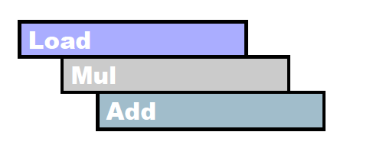
Without chaining, we must wait for last element of
result to be written before starting dependent
Instruction.
With chaining, we can start dependent instruction
as soon as first result appears.

Slide 12
We define a chime as the unit of time to execute one
convoy.
Therefore, m convoys execute in m chimes.
Suppose the vector dimension is n. Each chime is n clock
cycles.
The execution of m convoys then needs m × n clock cycles.

Slide 13
Example:
Consider the following example.
  fld f0,a ; load scalar a
  vld v0,x5 ; load vector X
  vmul v1,v0,f0 ; vector-scalar multiply
  vld v2,x6 ; load vector Y
  vadd v3,v1,v2 ; add
  vst v3,x6 ; store the result
There are three convoys:
1. vld and vmul
2. vld and vadd
3. vst
There are 3 chimes.
For 64 element vectors, requires 64 x 3 = 192 clock cycles

Slide 14
Multiple lanes
The number of lanes indicates the number of parallel
pipelines in the vector functional unit. So far we only
considered single-lane vector functional unit. The extension
of RV64V for multiple lanes is also possible.

Slide 15
Single-lane
for C ⬅ A+B
A[9]
A[8]
A[7]
A[6]
A[5]
A[4]
A[3]
A[2]
A[1]
B[9]
B[8]
B[7]
B[6]
B[5]
B[4]
B[3]
B[2]
B[1]
4-lane
For C ⬅ A+B
A[8]
A[4]
B[8]
B[4]
A[9]
A[5]
B[9]
B[5]
A[6]
B[6]
A[7]
B[7]
+
+
+
+
+
C[0]
C[0]
C[1]
C[2]
C[3]
C[0]⬅ A[0]+B[0]
C[1]=A[1]+B[1]
C[2]=A[2]+B[2]
C[3]=A[3]+B[3]

Slide 16
Architecture of 4-lane vector functional unit:
the functional unit consists of 4 adders, and 4 multipliers.
Lane 0
Lane 1
Lane 2
Lane 3
FP add
Pipe 0
FP add
Pipe 1
FP add
Pipe 2
FP add
Pipe 3
Vector
Registers:
elements
0,4,8,…
Vector
Registers:
elements
1,5,9,…
Vector
Registers:
elements
2,6,10,…
Vector
Registers:
elements
3,7,11,…
FP mul
Pipe 0
FP mul
Pipe 1
FP mul
Pipe 2
FP mul
Pipe 3
Vector Load/Store Unit

Slide 17
Adding multiple lanes is a popular technique to improve
vector performance as it requires little increase in control
complexity and does not require changes to existing
machine code.
It also allows designers to trade off die area, clock rate,
voltage, and energy without sacrificing peak performance.
If the clock rate of a vector processor is halved, doubling
the number of lanes will retain the same potential
performance.

Slide 18
SIMD Instruction Set Extensions for Multimedia
SIMD Multimedia Extensions started with the simple
observation that many media applications operate on
narrower data types than the 32-bit processors were
optimized for.
For example, many graphics systems used 8 bits to represent
each of the three primary colors.

Slide 19
Basic Idea
By partitioning the carry chain within a 256-bit adder, a
processor could perform simultaneous operations on
short vectors of thirty-two 8-bit operands, sixteen 16-bit
operands, eight 32-bits operands, or four 64-bits operations.

Slide 20
Implementations
For the x86 architecture, the MMX instructions added
in 1996 repurposed the 64-bit floating-point registers,
so that the basic instructions could perform eight 8-bit
operations, or four 16-bit operations simultaneously.
The Streaming SIMD Extensions (SSE) successor in 1999
added separate registers that were 128 bits wide, so now
instructions could simultaneously perform sixteen 8-bit
operations, eight 16-bit operations, or four 32 bit operations.

Slide 21
The Advanced Vector Extension (AVX), added in 2010,
doubles the width of the registers again to 256 bits and
thereby offers instructions that double the number of
operations on all narrower data types.

Slide 22
Examples
Here we add 256-bit SIMD multimedia instructions to RISC-V.
We add the suffix “4D” on instructions that operate on
Four double-precision operands at once.
Again, consider the following vector problem
Y=a × X + Y,
where X and Y are vectors, and each contains 4 double
precision numbers.

Slide 23
Assume all the F registers (i.e.,f0-f32) have 256 bits.
fld f0,a ;load scalar a
splat.4D f0,f0 ; Make 4 copies of a
addi x28,x5,#256 ;last address to load
Loop: fld.4D f1,0(x5) ;load X[i], X[i+1], X[i+2], X[i+3]
fmul.4D f1,f1,f0 ;a×X[i],a×X[i+1],a×X[i+2],a×X[i+3]
fld.4D f2,0(x6) ;load Y[i], Y[i+1], Y[i+2], Y[i+3]
fadd.4D f2,f2,f1 ;a×X[i]+Y[i], ..., a×X[i+3]+Y[i+3]
fsd.4D f2,0(x6) ;store into Y[i], Y[i+1], Y[i+2], Y[i+3]
addi x5,x5,#32 ;increment index to X
addi x6,x6,#32 ;increment index to Y
bne x28,x5,Loop ;check if done

Slide 24
Note that in this example, the SIMD instruction
fld.4D f1,0(x5)
Actually performs f1⬅{Mem[x5], …, Mem[x5+31]}
(32 bytes, 256 bits),
where
X[i]= {Mem[x5],…,Mem[x5+7]} (8 bytes, 64 bits)
X[i+1]= {Mem[x5+8],…,Mem[x5+15]} (8 bytes, 64 bits)
X[i+2]= {Mem[x5+16],…,Mem[x5+23]} (8 bytes, 64 bits)
X[i+3]= {Mem[x5+24],…,Mem[x5+31]} (8 bytes, 64 bits)

Slide 25
Graphics Processing Units
Given the hardware invested to do graphics well, how can we supplement it to improve performance of a wider range of applications?
One solution is to develop a general purpose Graphical Processing Unit (GPU).

Slide 26
Basic Idea
  1. A heterogeneous execution model is proposed.
    CPU is the host, GPU is the device.
  2. A C-like programming language is developed for GPU.
  A typical example is CUDA (Compute Unified
  Device Architecture) provided by NVIDIA.
  3. All forms of GPU parallelism is unified as CUDA thread.
  4. CUDA Programming model is “Single Instruction
  Multiple Thread (SIMT)”

Slide 27
Thread and Blocks in CUDA
1. A thread is associated with each data element.
2. Threads are organized into blocks.
3. Blocks are organized into a grid.
4. GPU hardware handles thread management, not
applications or OS.
5. The hardware that executes a whole block of threads
is called a streaming multiprocessor (SM).

Slide 28
Some CUDA details
1. To distinguish between functions for the GPU (device) and
functions for the CPU, CUDA uses _global_ or _device_
for the former, and _host_ for the later.
2. The syntax of function call for the function name that runs
on the GPU is
name <<<dimGrid, dimBlock>>>(…parameter list…)
where dimGrid and dimBlock specify the dimensions of
a grid (in blocks), and the dimensions of a block
(in threads).

Slide 29
3. Other important keywords include
blockIdx: the identifier for blocks,
threadIdx: the identifier for threads per block,
blockDim: number of threads per block (comes from
Dimblock).

Slide 30
Example
Let’s start with conventional C code for the following
vector problem
Y=a × X + Y.
//
daxpy(n,2.0,x,y);
//
void daxpy(int n, double a, double *x, double *y)
{
for (int i=0; i<n; ++i)
y[i]=a*x[i]+y[i];
}

Slide 31
Below is the CUDA version. It consists of a host
code and a device code.
_host_
int nblocks = (n+255)/256;
daxpy<<<nblocks,256>>>(n,2.0,x,y);
_global_
void daxpy(int n, double a, double *x, double *y);
{
int i= blockIdx.x*blockDim.x+threadIdx.x;
if (i<n) y[i]=a*x[i]+y[i];
}

Slide 32
As we can see from this example, a CUDA program consists
of one or more phases that are executed on either the host
(CPU), or a device such as a GPU.
The phases that exhibit little or no data parallelism are
implemented in host code.
The phases that exhibit rich amount of data parallelism are
implemented in the device code.

Slide 33
A device code is called a kernel in CUDA. When a kernel
is invoked (or launched), a grid of threads is created. The
kernel is executed by each individual thread. The threads
are grouped into blocks for the execution in a streaming
multiprocessor.
In this example, n threads, one per vector elements, are
created. Each block contains 256 threads.

Slide 34
The index for each thread in this example contains two
components: blockIdx.x and threadIdx.x. The first
component specifies the block ID number of the thread,
and the second component specifies the thread ID number.
blockIdx.x
. . .
threadIdx.x
blockDim.x

Slide 35
Thread Assignment
Recall that threads are assigned to streaming multiprocessors
on a block-by-block basis.
In a GPU, there are a number of streaming multiprocessors
capable of operating concurrently.
For example, NVIDIA GT200 implementation has 30
streaming multiprocessors.

Slide 36
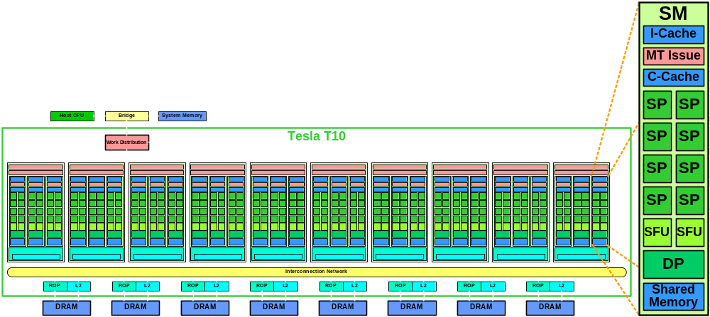
Architecture of GT200: there are 30 SMs.
Each SM contains 8 streaming processors (SPs, or cores).
Therefore, there are 30 × 8 =240 cores in the GT200.

Slide 37
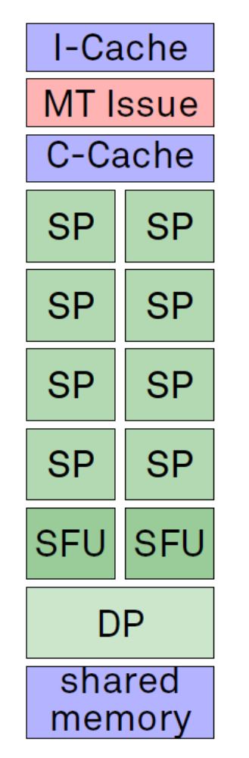
Block Diagram of a Streaming Multiprocessor
I-Cache: Instruction Cache
MT Issue: Multi-Thread Issue (Warp Scheduler)
C-Cache: Constant Cache (Read-Only Data Cache)
SP: Streaming Processor (Core)
Single Precision floating point,
Integer
SFU: Special Function Unit (sin, cos, log,…)
DP: Double Precision unit

Slide 38
Architecture of a Streaming Multiprocessor
Instruction
Cache
Warp Scheduler
Instruction Register
Streaming Processors
Registers
Registers
Registers
Registers
Registers
Registers
Registers
Registers
Load/Store
Unit
Load/Store
Unit
Load/Store
Unit
Load/Store
Unit
Load/Store
Unit
Load/Store
Unit
Load/Store
Unit
Load/Store
Unit
Shared Memory

Slide 39
In the GT200, up to 8 blocks can be assigned to
each streaming multiprocessor as long as there are
enough resources to satisfy the needs of all the blocks.
With 30 streaming multiprocessors, up to 240 blocks can
be simultaneously assigned to them. Most grids contains
many more than 240 blocks. The runtime system maintains
a list of blocks that need to execute, and assigns new
blocks to streaming multiprocessors as they complete the
execution of blocks previously assigned to them.

Slide 40
Thread Scheduling
Thread scheduling is strictly an implementation concept,
and must discussed in the context of specific hardware
implementation.
In the GT200 implementation, once a block is assigned to
a streaming multiprocessor, it is further divided into
32-thread unit called warps.
The warp is the unit of thread scheduling in streaming
multiprocessors.

Slide 41
In fact, warps are not part of the CUDA specification;
however, knowledge of warps can be helpful in
understanding and optimizing the performance of CUDA
applications on particular generations of CUDA devices.

Slide 42
The division of blocks into warps is based on the simple
rule that each warp consists of 32 threads of
consecutive threadIdx values.
Threads 0 through 31 form the first warp,
Threads 32 through 63 the second warp, and so on.

Slide 43
Each streaming multiprocessor contains 8 cores in GT200.
Each core can execute 1 thread.
Therefore, each streaming multiprocessor can execute 8 threads in parallel.
SIMT can discover which threads of a warp can execute the same instruction together.
When SIMT is used, the execution time is then 4 clock cycles for one instruction in each warp.

Slide 44
Example
Suppose 4 blocks are assigned to a streaming multiprocessor.
Each block has 256 threads. Therefore, there are 256/32=8
warps per block.
It then follows that there are 4×8=32 warps in the streaming
multiprocessor.

Slide 45
We now compare a GT200 SM to a SUN UltraSPARC T2 core.
Both architectures are multithreaded by scheduling threads
over time.
The GT200 SM can schedule up to 32 warps over time based
on fine-grained hardware multithreading. The execution time
is 4 clock cycles for one instruction in each warp.
Each UltraSPARC T2 core can schedule 8 threads over time.
The T2 core contains only a single multithreaded processor.
The execution time is 1 clock cycle for one instruction in each
thread.

Slide 46
Ultra Sparc T2
GT200 Streaming
Multiprocessor
■
Thread 0
■
■
■
■
■
■
■
■
■
Thread 1
■
■
■
■
■
■
■
■
■
■
■
■
■
■
■
■
■
Warp 0
■
■
■
■
■
■
■
■
■
■
■
■
■
■
■
■
■
■
■
■
■
■
■
■
■
■
■
■
■
Thread 7
■
■
■
■
■
■
■
■
Warp 1
■
■
■
■
■
■
■
■
…
■
■
■
■
■
■
■
■
■
■
■
■
■
■
■
■
■
■
■
■
■
■
■
■
Warp 31
■
■
■
■
■
■
■
■
Time

Slide 47
Latency Hiding
Why do we need to have so many warps in a streaming
processor?
The answer is that this is how GPU efficiently execute
the long-latency operations such as global memory
accesses.
When an instruction executed by the threads in a warp must
wait for the result of a previously initiated long-latency
operations, the warp is not selected for execution.
Another resident warp that is no longer waiting for results
is selected for execution.

Slide 48
Note that warp scheduling is also used for tolerating other
types of long-latency operations such as floating point
arithmetic and branch instructions.
With enough warps around, the hardware will likely to find
a warp to execute at any point in time, thus making full use
of execution hardware.

